Slide 1
Notes:
Hello Everyone. My name is _______________ and I am a volunteer presenter with the program Conversations Worth Having, the local Advance Care Planning Education Program. Thank you so much for inviting me to speak to you today.

Slide 2
Imagine: You’re in the hospital, too ill or hurt to speak for yourself…
Think: Do you know who would make health care decisions for you?
Notes:
While we are going through the presentation, I would like to you consider the following questions….(Click and read each line)
Further to this, do THEY know they will make your health care decisions for you?
And do you think they would feel confident making your health care decisions the way you would if you could speak?

Slide 3
Imagine: Your spouse or partner has had a stroke and is unable to communicate with doctors
Think: Would you know what health care they would want or not want?
Notes:
Alternatively, I’d like you to imagine…..(click and read each line)

Slide 4
Advance Care Planning & Health Care Consent
Notes:
This is what Advance Care Planning is all about. It is about planning for a time when you are incapable of making your own health care decisions. (Emphasize HEALTH CARE decisions).

Slide 5
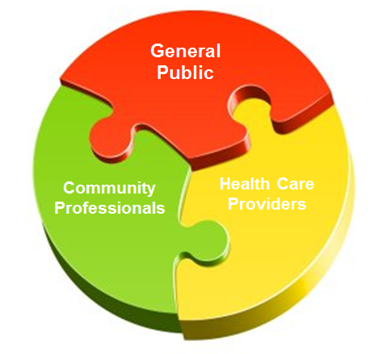
3 yr project 2015-2018
Collaboration between Hospice Waterloo Region and Hospice Wellington
Continue to provide education and resources to reach across Waterloo Wellington
Notes:
Before we get into it, I would like to share a little bit about the Conversations Worth Having program which ended in March 2018. It was a collaboration between Hospice Waterloo Region and Hospice Wellington, with the goal of increasing people’s awareness, understanding and behaviour relating to Advance Care Planning. It was funded by the Local Health Integration Network over three years – 2015-2018 and was unique in its effort to reach the 1) general public, like yourselves, 2) community professionals such as lawyers and financial planners – those people who are helping others plan for their future and 3) health care providers in a variety of settings from hospitals, to family health teams, to community health centres. While the government funding has ended, both Hospice Waterloo Region and Hospice Wellington continue to provide Volunteer presenters, ACP resources while also maintaining the acpww.ca website .

Slide 6
Putting into Context
Before providing any treatment health care providers must obtain informed consent from:
Patient
Substitute Decision Maker (if the patient is mentally incapable)
Only exception of when consent is not needed is in an EMERGENCY
Adapted from Judith Wahl with permission
Notes:
So, to put Advance Care Planning into context….before providing any treatment…..click through points.
Note following point 2: Many people believe that Health Care Providers can decide what treatments to give you; however, in Ontario, this is not the case. Health care providers MUST get consent (permission) before doing anything to you. This includes small things such as changing Advil to Tylenol, to big things like open heart surgery. Consent is always needed. The ONLY exception when a health care provider does not need to get consent is if it is an emergency. This means that there is a large risk of death or serious injury. But, once the person is stabilized, they then have to begin getting consent. Either from the patient, if they are mentally capable, or from their Substitute Decision Maker.

Slide 7
What is Advance Care Planning in Ontario?
Identifying your future Substitute Decision Maker
Having conversations about what is important to you
Notes:
So what is advance care planning in Ontario? It is important to note that Ontario law about Advance Care Planning and Health Care Consent is very different from other provinces. There is confusion about Advance Care Planning in part due to people using information from other provinces or from the United States. When looking at information, make sure it is from Ontario.
In Ontario, advance care planning is:
Identifying who your substitute decision maker is – the person or people who will make your health care decisions for you in the event you are mentally incapable of making them for yourself and,
Having conversations with them, and your other loved ones, about what is important to you
And both of these things should happen long before there is a crisis.

Slide 8
Step 1: Identifying your Substitute Decision Maker
There are two ways to identify your SDM in Ontario:
Complete a Power of Attorney for Personal Care
Confirm the automatic person on the hierarchy
Notes:
In Ontario, there are two ways to determine who your Substitute Decision Maker is:
Most of us have heard of a Power of Attorney for Personal Care – this is a document that we can complete to name a person or people to be our Substitute Decision Maker for health care. You do not have to go to a lawyer to get this done, although it may be a good idea. We have booklets about Powers of Attorney that you are free to take at the end of the session.
However, most of us don’t realize that we all have a Substitute Decision Maker, even if we haven’t completed a Power of Attorney for Personal Care. This is based in law, and I am going to go through it with you on the next slide.
We always get a lot of questions about the hierarchy, so please feel free to ask questions!

Slide 9
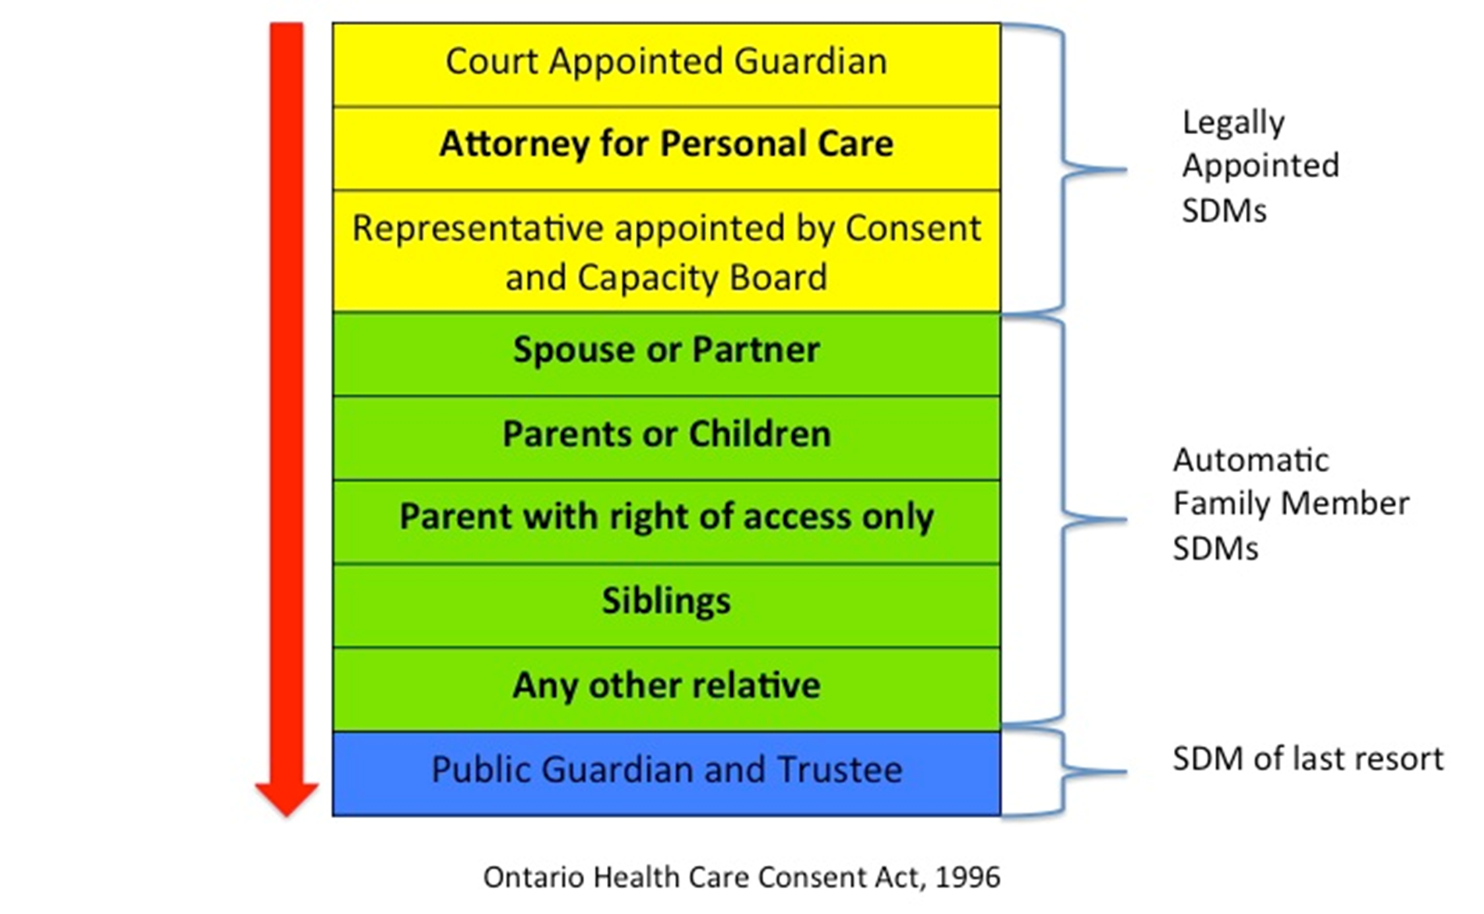
Hierarchy of SDMs HCCA s. 20
Notes:
These notes below are not meant to be read verbatim but it is a resource for you as the facilitator to be able to explain in detail.
The Ontario Health Care Consent Act, includes a hierarchy that provides every person in Ontario with an automatic SDM(s). Even if you have never done a Power of Attorney for Personal Care.
The person/persons in a person’s life that are the highest ranked in this hierarchy and that meet the requirements to act as a SDM(s) will be their SDM(s) for health care
For example, if I end up in hospital today and I am incapable, the health care providers must figure out who my highest ranking Substitute Decision Maker is. They must start at the top of this list and make their way down until they find the person/people
Often get questions about how they know who your SDM is. One answer is that we have created a wallet card (show them the card) that we encourage people to complete and carry in their wallet so that health care providers can use it as a starting point. Important to note that it is NOT a legal document. It is just to help them start in the right direction.
As you can see, the first three in yellow are Legally Appointed SDMS. Someone actually has to DO something in order to be appointed at SDM or to appoint an SDM.
Guardian of the person: This is someone that is appointed by the court to be your SDM. This is a very rare circumstance that is lengthy and expensive. If you have not gone through a lengthy court process to get guardianship over another person, this level does not apply. In essence, you would know if you have done this. An example of this in case people ask is: imagine two siblings are SDMs for their mom. If they cannot get along and agree on decisions for mom, and one believes that the other is not acting in their mother’s best interest, one (or both) could apply to be her Guardian. They have to hire a lawyer, make a case as to why they should be the SDM over their sibling.
Attorney named in a Power of Attorney for Personal Care: This is the most common type of legally-appointed SDM. This is the person/persons you have chosen to be your SDM(s) if you prepared this document when you were mentally capable to do so. Most people who complete a Power of Attorney for Personal Care do so when they do their Estate Planning – they do their Will, Power of Attorney for Property/Finance and Power of Attorney for Personal Care. You can name more than one person in a Power of Attorney – however, many lawyers recommend that you name one, maybe two people to act. Conflict can occur even if they are named Jointly and Severally (meaning they can make decisions together or separately). It may also be a good idea to name alternates – if so and so is unavailable or unable to act, THEN go to this person, if this person is not available or incapable, THEN go to this person.
Representative appointed by the Ontario Consent and Capacity Board: One of your family or friends could apply to the tribunal to be named as your “Representative,” which is a type of SDM. Someone can apply to be a person’s representative only after the person has been deemed incapable. An example of this: Imagine 85 year old Betty, who lives by herself, has no family and has never done her POA for Personal Care, ends up in hospital, unconscious. Her neighbour, who has known Betty for years, can apply to the Consent and Capacity Board to be appointed her SDM.
So, if you have not taken any of the legal steps above, that’s okay! Because in Ontario, everyone has an automatic, default SDM. The following 5 in green are your Family member SDMs, in ranking order.
Spouse or partner. Your spouse or partner is your highest ranking family-member SDM. It means same sex or opposite and two persons are “spouses” if they are:
Married to each other; or
Have a common-law relationship: must be living together for at least one year.
Two people are “partners” if they have lived together for at least one year and have a close personal relationship that is of primary importance in both people’s lives. This can include friends who have lived together for at least one year in a non-sexual relationship and have a special personal family-like relationship.
Note. Two persons are not spouses if they are living separate and apart as a result of a breakdown of their relationship.
Child or parent or Children’s Aid Society – This level includes adult children and parents. So, if someone has adult children AND living capable parents, all are equally ranking Substitute Decision Makers. “Sandwich generation”. This means, if you have 5 adult children and living capable parents, they are all your SDM together. I don’t often talk about Children’s Aid as it isn’t relevant to most audiences.
A parent who only has a right of access. – This is when one parent has full custody and the other parent only has visiting rights. The parent with full custody outranks the one with visitation rights only.
6. Brother or sister – this is ALL your brothers and sisters.
7. Any other relative. This is by blood, marriage or adoption. They are literally looking for anyone related to you to make your health care decisions. E.g., aunts, uncles, nieces, nephews, in-laws, cousins, grandchildren, etc.
9. If no person in your life meets the requirement to be a SDM, then the Office of the Public Guardian and Trustee is your SDM – this is a last resort. It is a specific body of the Ontario Government that specializes in making health care decisions for people who have nobody else to make decisions for them. For example, if a person living in a shelter literally has nobody on levels 1 through 8 and requires treatment and is incapable, the health care providers must called the Public Guardian before doing any treatment. They just can’t give the treatment without consent. The PGT also acts as SDM if there are equally ranking SDMs who cannot agree on a decision.

Slide 10
What do SDMs do?
Make health care and personal care decisions for you
Only make decisions if you DO NOT HAVE CAPACITY
Have to make the decisions the way YOU would have made them
Must use previously expressed wishes
Act in your best interest
Notes:
Your SDM must use any wishes you expressed to them while you were capable. This is true even if the SDM does not agree with the decision. For example, an older woman had named one of her daughters in her Power of Attorney for Personal Care. She told her daughter that she did not want, under any circumstance, to be put on life support – no matter what. Her daughter said “well, Mom, I am going to do whatever it takes to keep you alive as long as possible, so if I have to put you on life support I will”. Her mother subsequently removed her daughter from the Power of Attorney document and named her son as he would follow her wishes. It is all about us having our voice heard, even if our SDM does not agree with the decision.
If no conversations have taken place, and wishes are unknown, the SDM must act in the person’s best interest. This is a legal term that requires the SDM to think about the vales and beliefs of the person, take into consideration any wishes the person may have expressed while incapable and think about if the treatment will likely improve the person’s condition or prevent further deterioration. Example is to think about what the person found important in life – did they have any religious beliefs? What did they enjoy doing?

Slide 11
Requirements to act as SDM
Capable with respect to treatment proposed
At least 16 years old
There is no court order or separation agreement prohibiting access to the incapable person or giving or refusing consent on his or her behalf
Is available
Is willing to assume the responsibility of giving or refusing consent
Notes:
If you are deemed mentally incapable of making a health care decision, the health care provider must turn to your SDM. However, they are determining if your SDM has capacity as well. For example, it can become tricky for people who are living with dementia. If the wife is mentally incapable of making her health care decisions and her spouse is her automatic SDM, he may not have the mental capacity himself to make her decisions for her in that moment. The health care team will be assessing both people’s capacity. If SDM is incapable, they then turn to the next person/people on the list. Or if you and your SDM are in the same car accident and he/she is unconscious, they are incapable of acting as your SDM.
A person only needs to be 16 years old to make health care decisions for another person. This is different than making financial decisions, where the age is 18. An example of this is a 17 year old young man was his father’s SDM – his father was divorced and the son was over the age of 16. His father had a long illness that eventually made him incapable. The 17 year old had to make the difficult decision to remove his own father from life support. However, the good news is that the father had many conversations with his son to tell him what was important to him and when he wanted his son to “let him go”. These conversations allowed the son to feel confident with his decision since he knew that his dad would have made the same decision if he could have spoken. Now, the son is able to grieve the loss of his father without second-guessing his decision and feeling guilty for the rest of his life.
Cannot be a court order against the SDM (I usually do not go into detail about this)
The SDM must be available. This can be in person, on the phone, via text message, email, Skype, etc. As long as the health care team can get a hold of the SDM in a time frame necessary and can confirm the identity and explain the situation, they can act as the SDM. For example, you can be in Australia and still act as someone’s SDM here in Ontario. Is it ideal? Probably not. But it is the law.
Nobody can be forced to be an SDM! This is even true is someone is named in a Power of Attorney for Personal Care. You are allowed to refuse. An example of why someone may refuse is that it is too emotionally taxing.

Slide 12
Types of Decisions
Long-term care placement
Health care decisions
Consent or refuse tests, procedures, surgery
Begin or withdraw life-prolonging measures
Who will provide medical care
Speaking with health care professionals
Admit or discharge from medical facility
Looking at medical information
Personal Assistance Services
Notes:
Types of decisions SDMs may make fall into 3 main categories:
Deciding if a person is moved into Long Term Care. It is the CCAC that will determine if the person has the capacity to make the decision for him/herself. If they do not, the SDM will then make the decision.
Health care decisions ranging from small decisions like changing mom’s Advil to Tylenol, to open heart surgery, to removing her from life support.
This means assistance with or supervision of hygiene, washing, eating, psw support, etc.

Slide 13
Advance Care Planning in Ontario
Does not need to be in writing
Later wishes, however communicated, expressed while capable prevail over earlier wishes
This is true even if the previous wishes were in writing and the later wishes are oral
Not only about End-of-Life
Not about Living Wills or Advance Directives
Notes:
Contrary to popular belief, you do not need to write your health care wishes down for them to be followed. In Ontario, our laws are very different from other provinces and jurisdictions. You can express your wishes in any way you can – verbally, in writing, in a video, etc.
The law in Ontario allows for people to change their minds. If you have changed your mind about a certain wish, it is important to share that with your SDM as they have to use your most recent wishes to make decisions. This is true even if you originally wrote down your wish but then changed your mind verbally.
Advance Care Planning is not only for those who are near the end of their life. Accidents and illness can happen at anytime and health care decisions are needed in situations where death is going to occur.
Many people believe that we have Advance Care Directives here in Ontario, where you write down health care wishes for the doctor to follow. We do not have advance care directives here. When we express our wishes, it is for the Substitute Decision Maker to follow, not the doctor, as consent needs to be given by the Substitute Decision Maker, not a piece of paper.

Slide 14
Step 2
Conversations with Substitute Decision Maker
and other loved ones
Notes:
All of that was Step 1! Determine who you will make your health care decisions in the event you are incapable of making them for yourself.
Step 2, and a very important step that many people do not do, is having conversations with your SDM, and other loved ones, about your wishes, values and beliefs. What do they need to know about you in order to make decisions the way you would make them if you could talk?
Many people go to their lawyer and do their Power of Attorney for Personal Care, take it home, put it in a “safe place” never to speak of it again. Many people don’t even tell the person they have named in the document that they have chosen them.
What we are encouraging is, once you’ve decided who your SDM, have conversations with them about what’s important to you.
I have a short video, created in the United States by The Conversation Project, to demonstrate the importance of having conversations.

Slide 15
Remember:
Your SDM has to make your health care decisions the way YOU would have made them
Sharing your wishes, values and beliefs with them in advance can help them make these decisions for you
These are conversations worth having…

Slide 16
Conversation Video

Slide 18
Ideas for how to bring up the conversation…
Notes:
We have gotten a lot of feedback from participants telling us that they really want to have these conversations with their loved ones but just don’t know how to start it. We have a video to show you that is 6 people who each had to bring the conversation up with their loved ones. In the video they each explain what it was like for them.

Slide 19
Conversation Video

Slide 22
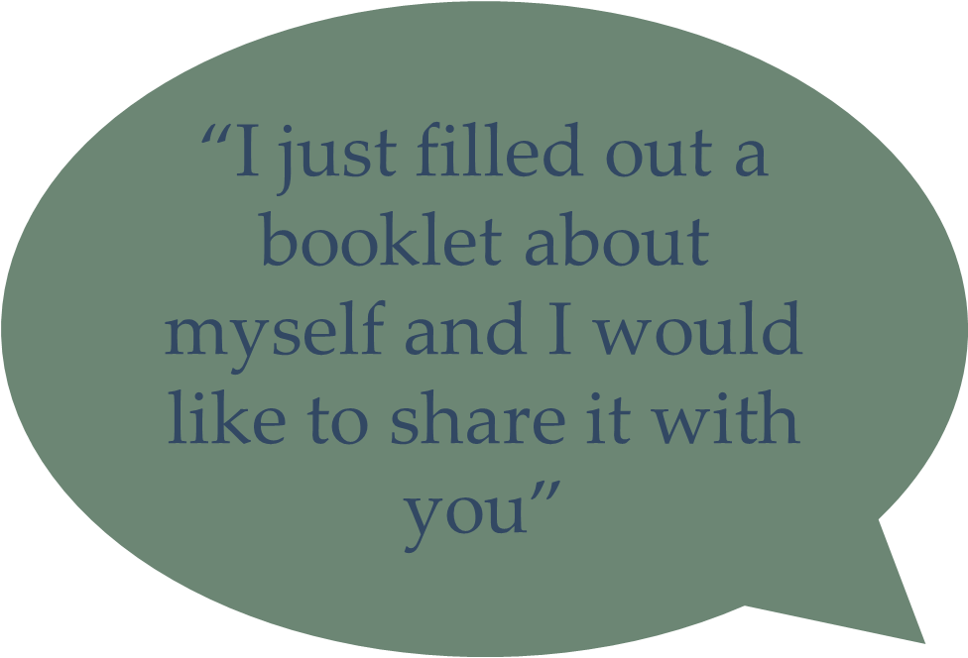
How to start
“I was thinking about what happened to_____ and it made me realize…”
“I need your help with something”
“I was at a workshop today and I would like to share the information I learned with you”
Notes:
Here are some examples of how you can bring up these conversations. Remember, there are lots of ways to bring it up. These are just a few ideas.

Slide 23
What to talk about…
Notes:
Now that you’ve brought the conversation up, you need to talk about something! The next few slides have some concrete examples of what to talk about and you’ll notice that they don’t have to be dark and dreary conversations!

Slide 24
Debrief
How did you feel doing this exercise?
Do you regularly think about these things for yourself?
Have you shared this information with your SDM?
Notes:
I am not sure if any of you have read the book called Being Mortal by Dr. Atul Gawnde. Gawnade in a surgeon in the US who is trying to shift the conversation from talking about medical interventions to more about you are as a person. One of his patients said…(read slide)
Now at first glance this seems totally useful for making serious health care decisions for someone else. But, it is actually very helpful because this man’s SDMs can now ask the doctors “if dad has this surgery, will it allow him to eat ice cream and watch football?” If the answer is no, they may so no to the treatment because dad has indicated this is what is important to him.

Slide 25
Examples
What are your “football and ice cream” must haves?
What 3 non-medical facts should your doctor know about you?
How would you describe yourself to someone who didn’t know you?
What fears do you have about your health?
Notes:
Here are some examples of what your SDM may benefit from knowing about you….everyone is different which is why it is so important to have these conversations!

Slide 26
Examples
What habits or hobbies make your life worth living?
What is a good day for you?
What matters most about living?
Do you want your doctor to focus on maximizing the quantity or quality of your life

Slide 27
Examples
Dr. Michael Gordon, MD, MSc, FRCPC
“Quality of life is hard to define, but we sure know when we don’t have it”
Notes:
Now I know that the term quality of life is very abstract and people often have a hard time with it. But this quote from a doctor who was in our region a few months ago sums it up really nicely (read quote). All of us can think of a time when the quality of our life was not acceptable to us. Think about that time and what it was about the situation that wasn’t acceptable and share that with your SDM.

Slide 28
Jazz Singer Video
Notes:
This last video, exemplifies how people’s wishes are very personal. Some people want everything medically possible done to extend their lives while other choose quality of life rather than length of life.

Slide 30
Benefits of ACP
Improves patient & family satisfaction with care
Decreased caregiver distress & trauma
Decreased unwanted investigations, interventions & treatments
Pts more likely to die in preferred setting, with earlier palliative care involvement
Less likely to be hospitalized & admitted to critical care
Decreased cost
Dr. Jeff Myers
Notes:
There are many benefits of Advance Care Planning – one of which is the significant reduction in stress, second-guessing and depression of the Substitute Decision Maker. For example, if an SDM makes a serious health decision that results in the person’s death, if they had these conversations beforehand, they would feel more confident in the decision they made. They would be able to say “this is what mom would have done if she could talk”. Just like our young 17 year old friend I told you about earlier.
If these conversations don’t occur, SDMs must then use their best judgment and second guess their decisions which can result in anxiety and depression afterwards.
Also, speaking with your SDM about your wishes and what’s important to you allows your voice to be heard even when you can’t speak. It allows us to retain our autonomy and choice even when we can’t make these decisions for ourselves.

Slide 31
What’s next – Individual Level
Identify your Substitute Decision Maker by either:
Confirming person on hierarchy
Doing Power of Attorney for Personal Care
Complete the SDM card and keep in your wallet
Have the conversations with your SDM and your other loved ones about what is important to you
Notes:
So….what’s next. I would invite you to do the following things based on the information you have heard tonight…..
(Click through each point)

Slide 32
Resources
Notes:
We know this is a lot of information to take in! We have lots of resources that you can take home with you, including a worksheet that can help you walk through some questions about your wishes, values and beliefs. You can then use this to have conversations with your loved ones. Please take lots of resources on your way out.

Slide 33
We need your help
Working across the Waterloo Wellington area
About 750,000 people
We can’t do this alone!
Do you have connections with other groups who would be interested in this?
Church/Faith groups
Workplaces
Etc
Notes:
If you are involved in any groups you think would like to hear this this information, please let me know!

Slide 34
Evaluations
Notes:
As part of the program, we need to gather feedback from people who have attended our education sessions. If you wouldn’t mind taking a couple of minutes to fill out this quick evaluation it would be really helpful to us.
Hand evaluations out. Hand out pens if needed and make some sort of joke about people not stealing your pens.
People can return evaluations folded up or upside down.

